Slide 1
Chapter 4: Business Process and Functional Modeling

Slide 2
Objectives
Understand the process used to identify business processes and use cases.
Understand the process used to create use-case diagrams
Understand the process used to model business processes with activity diagrams.
Understand the rules and style guidelines for activity diagrams.
Understand the process used to create use case descriptions.
Understand the rules and style guidelines for use case descriptions.
Be able to create functional models of business processes using use-case diagrams, activity diagrams, and use case descriptions.

Slide 3


Objectives
■ Understand the rules and style guidelines for activity diagrams.
■ Understand the rules and style guidelines for use cases and use case diagrams.
■ Understand the process used to create use cases and use case diagrams.
■ Be able to create functional models using activity diagrams, use cases, and use case diagrams.
■ Become familiar with the use of use case points.

Slide 4
Introduction
Requirements determination (ch3)
Requirement definitions(ch3)
Business process identification
Use-case Diagram(ch4)
Business process modeling(external or functional view)
Activity Diagram(ch4)
Business process 문서화
Use-case Descriptions(ch4)

Slide 5
UML Diagrams
Interactions
Viewpoint
Functional
viewpoint
Sequence Diagram
Communication Diagram
Timing Diagram
Interaction Overview
Diagram
Use Case
Diagram
Component Diagram
Package Diagram
Class Diagram
Object Diagram
Deployment Diagram
Composite Structure
Diagram
State Machine Diagram
Behavioral
Protocol
Activity Diagram
Structural
viewpoint
Behavioral
viewpoint

Slide 6
Introduction
Now begin the process of turning the requirements into functional models
Models are logical; i.e., independent of how they are implemented (manual or computerized) – external or functional view제공
Logical model – problem domain model( use-case, activity dia)
Activity가 자동화되던 사람이 하던, 자료가 db에 저장되던 종위위에 적던 상관하지 않는다. 서류캐비넷에 저장하던지 자동화하던지…
Develop use-cases from the requirements
Use-case: how a business system interacts with its environment
Includes a diagram and a description to depict the discrete activities that the users perform
Develop activity diagrams from the use-cases
These model the business processes or how a business operates
Used to illustrate the movement of objects (data) between activities
Notes:
Logical model : 은 구현을 고려하지 않는 모델이나 나중에 설계 단계에서 구체화하게된다.

Slide 7
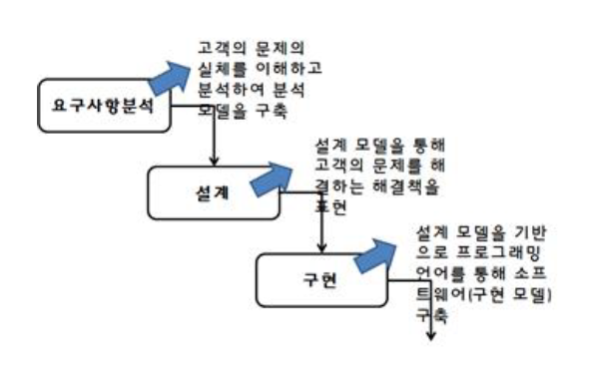
개발 모델

Slide 8
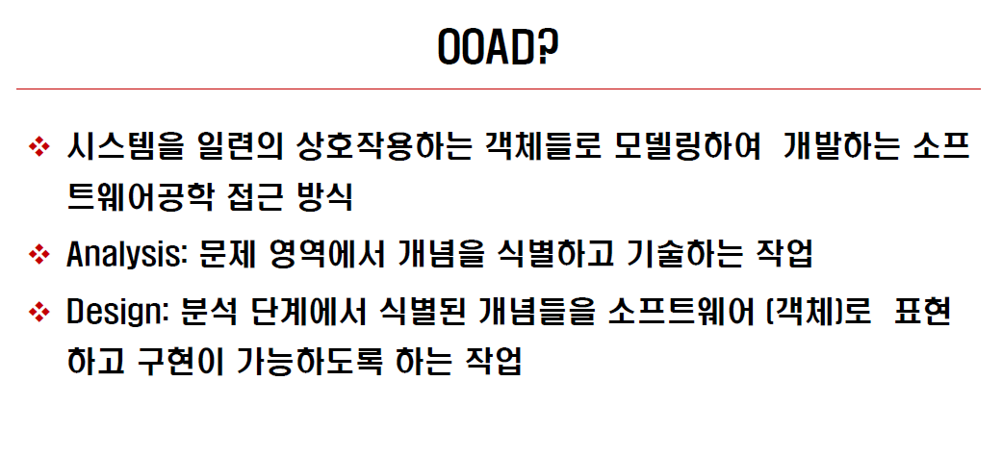

Slide 9
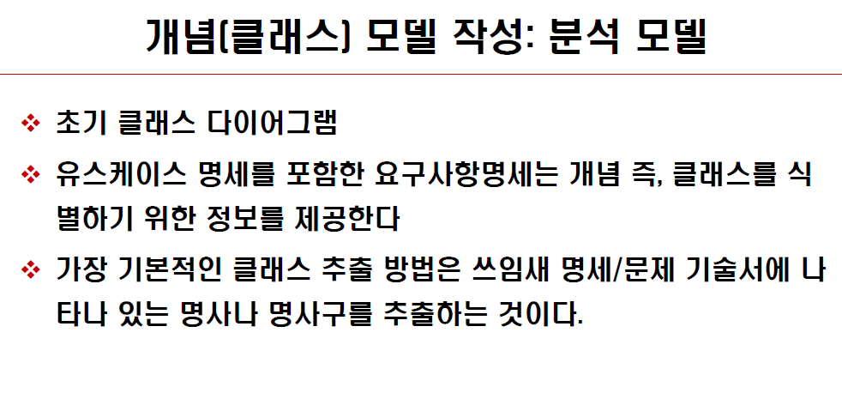

Slide 10
Domain

Slide 11
개념 모델을 통해 세상을 본다

Slide 12
모델링

Slide 13
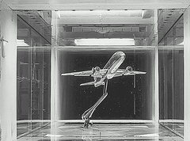
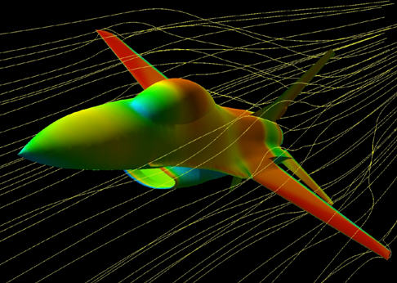
풍동실험모델

Slide 14
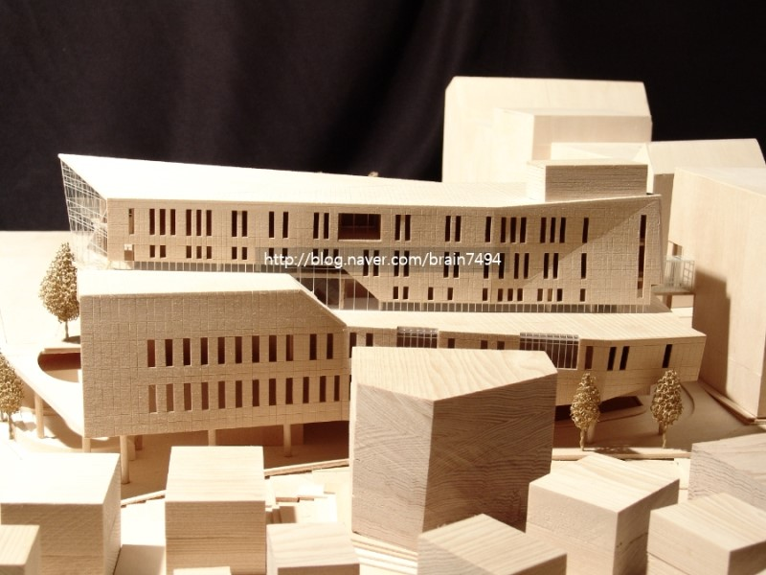
건축모델

Slide 15
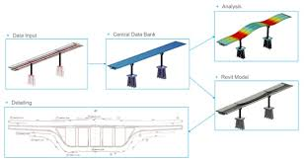
만들기 전 비교 분석

Slide 16
AR/VR
가상현실 모델
만들기 전 체험하기
만들기 전 살아보기

Slide 17
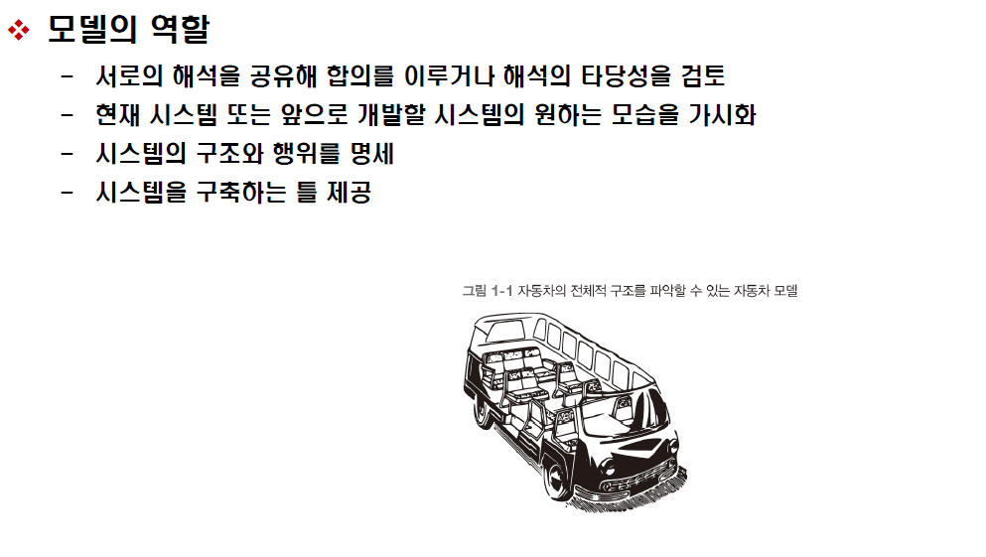
모델링

Slide 19
Business Process Modeling with Activity Diagrams
Elements of an Activity Diagram
Guidelines for Creating Activity Diagrams

Slide 20
BPM With Activity Diagrams
Business processes consist of a number of activities
Activity diagrams depict the sequence of these activities
Diagrams are abstract and describe processes in general
They model behavior independent of objects
Can be used for any type of process
Notes:
Biz process modeling
Biz process를 구성하는 activity를 묘사, 객체 개념과는 무관하다.
Functional decomposition mind set을 reinforc한다. – 제대로 사용한다면 분석가와 사용자 사이에 현제까지 이해한 요구를 통신하기에 좋다.
Martin schedllbauer
. Be realistic, 현실적 – 모든 것을 다할 필요 없다.
. Be agile –
. 팀으로 해결해라
. Case 사용치 말라 칠판을 이용해라
. 반복작업해라
. 작업중인 Specific process에 집중해라
. 현실의 추상 모델이다. 사소한것 제외, 혼란만 가중시킬 수 있다.
모든 종류의 process 를 (activit를) 모델할 수 있지만 여기서는 high-level biz processes에 집중한다.

Slide 21
BPM With Activity Diagrams
A number of activities support a business process across several departments
Activity diagrams model the behavior in a business process
Sophisticated data flow diagrams
Addresses Parallel concurrent activities and complex processes

Slide 22
Activity Diagram
Activity diagram for a printer server
Parallel actions
[disk full]
Show
MessageBox
“Disk full”
on screen
CustomerWindow.printFile( )
Show
MessageBox
“Printing”
on screen
[free disk
space]
Remove
MessageBox
^Printer.Print(file)
Create
postscript file
Sampler.Run(channel, frequency)
Initiate
Updating
displayer
Measuring

Slide 23
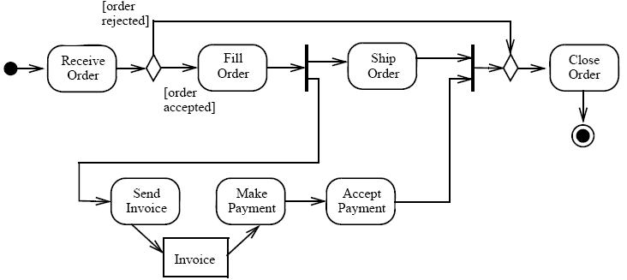
Example of Activity Diagram
Activity diagram for delivery activities

Slide 24
Swimlanes and passing Objects
Swimlanes
groups activities, with respect to their responsibility
to show explicitly where actions are performed
to show in which part of an organization work is performed
Objects
Objects are either input to or output from the actions in activity diagrams
Displayer
Sampler
Sampler.Run(channel, frequency)
Initiate
Updating
displayer
Measured
value
Measuring

Slide 25
Example of Swimlane

Slide 26
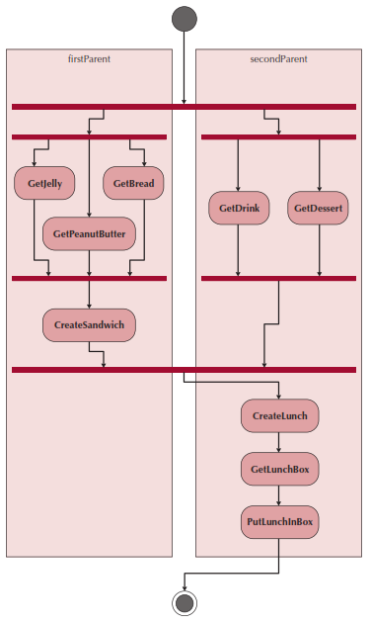
Swim lanes
Used to assign responsibility to objects or individuals who actually perform the activity
Represents a separation of roles among objects
Can be drawn horizontally or vertically

Slide 27
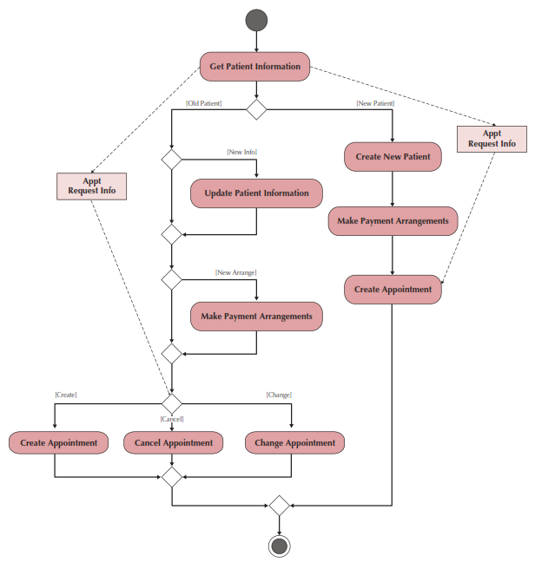
Sample Activity Diagram

Slide 28
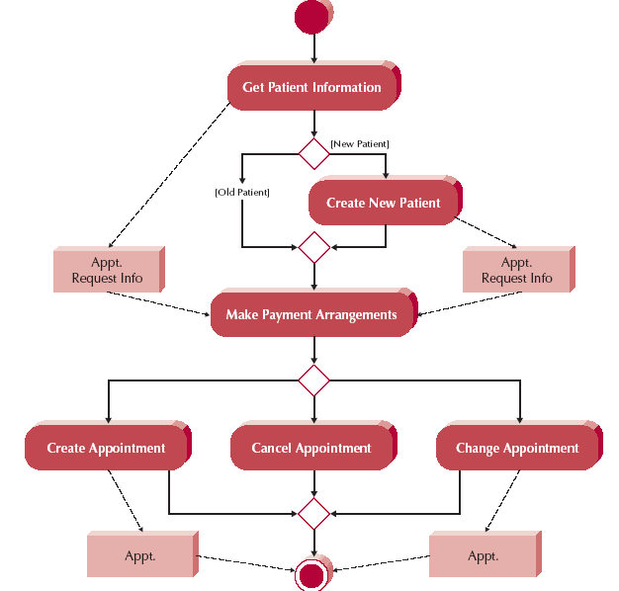
Activity Diagram Example

Slide 29
Activity Diagram Syntax
Action or Activity
Represents action or set of actions
Control Flow
Shows sequence of execution
Initial Node
The beginning of a set of actions
Final Node
Stops all flows in an activity
Decision Node
Represents a test condition
Notes:
Action or activity : behavior manual or computerized, 동사 + 명사 형태의 이름, action은 더 이상 세분화 됮 ㅣ않는다.
대부분 Activity는 use-case(동그라미)에 대응,

Slide 30
Elements of an Activity Diagram
Actions & Activities
Something performed for some specific business reason
Named with a verb and a noun (e.g., Get Patient Information)
Activities can be further sub-divided; actions cannot
Object Nodes: represent the flow of information from one activity to another
Control Flows: model execution paths
Object Flows: model the flow of objects
Control Nodes: 7 types

Slide 31
Control Nodes
Initial node: the beginning of the set of actions/activities
Final-activity node: stops all actions/activities
Final-flow node: stops one execution path but allows others to continue
Decision node: represents a test to determine which path to use to continue (based on a guard condition)
Merge node: rejoins mutually exclusive execution paths
Fork node: separates a single execution path into one or more parallel paths
Join node: rejoins parallel execution paths

Slide 32
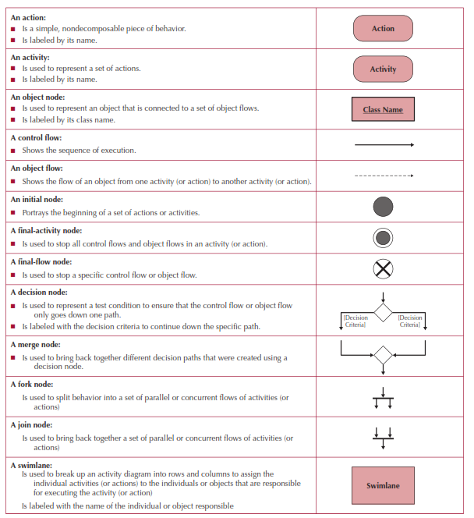
Activity Diagram Symbols

Slide 33
Guidelines for Activity Diagrams
Set the scope of the activity being modeled
Identify the activities; connect them with flows
Identify any decisions that must be made
Identify potential parallelism in the process
Draw the activity diagram

Slide 34
Creating an Activity Diagram
Choose a business process identified previously
Review the requirements definition and use-case diagram
Review other documentation collected thus far
Identify the set of activities used in the business process
Identify control flows and nodes
Identify the object flows and nodes
Lay out & draw the diagram (minimize crossing lines)

Slide 35
Activity 참고자료
http://dollipolly.tistory.com/entry/UML%ED%99%9C%EB%8F%99-%EB%8B%A4%EC%9D%B4%EC%96%B4%EA%B7%B8%EB%9E%A8

Slide 36
Activity diagram
정의 : 처리 로직이나 조건에 따른 처리흐름을 순서에 따라 정의한 모델
작성목적
처리순서 표현 (대상에 관계없이..)
비즈니스 프로세스 정의(이 용도로 가장많이 사용됨) : 업무의 As-is분석, To-be 분석 가능
프로그램 로직 정의 : 처리흐름의 도식화로 프로그램 로직 정의 가능
유즈케이스 실현

Slide 37
Activity diagram
작성시기 : 그 시점이 한정되어 있지 않고 다양하게 사용 가능
업무 프로세스 정의 시점.
유즈케이스 정의서 작성 시, 처리절차 기술할때
오퍼레이션 사양 정의시

Slide 38
Activity diagram
작성순서
작성대상 선정 : 업무프로세스 모델링, 오퍼레이션 사양 정의
→ Swim lane 정의 : 대상영역에 명확한 역할을 정의해야 할 때
→ 처리절차 모델링 : 시작점, 끝점 반드시 표현.
출처: http://dollipolly.tistory.com/entry/UML활동-다이어그램 [티라노]

Slide 39
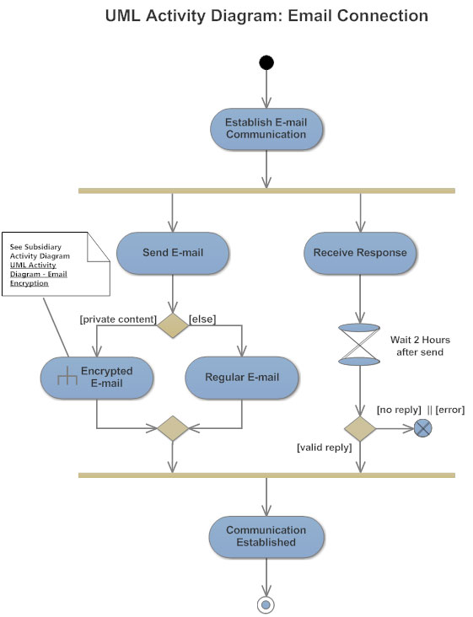

Slide 40
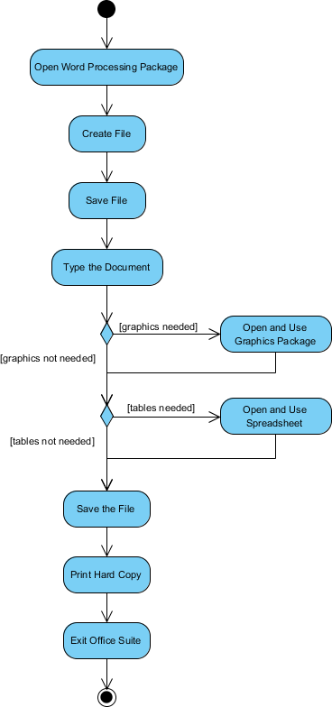

Slide 41
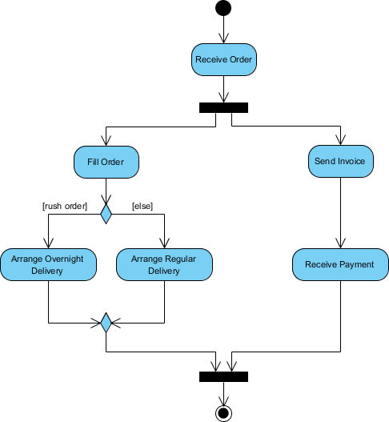

Slide 42
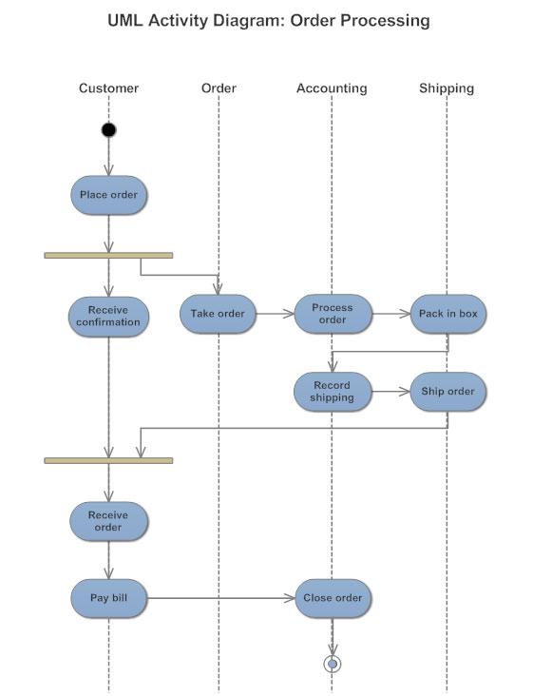

Slide 43
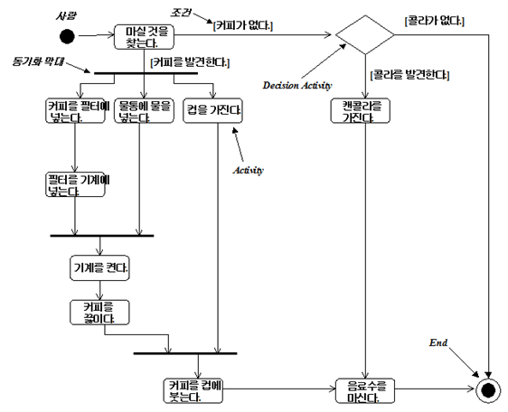

Slide 44
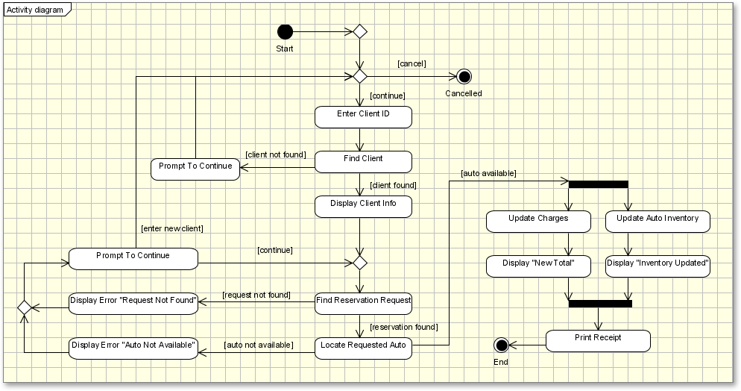

Slide 45
USE-CASE Modeling

Slide 46
Purpose of Use-Case Modeling
to decide and describe the functional requirements of the system
results in an agreement between the customer and software developers
to give a clear and consistent description of what the system should do
used throughout the development process to communicate to all developers those requirements

Slide 47
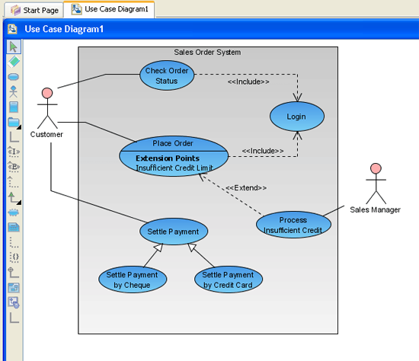
Use Case Diagram
Use case diagrams describe what a system does from the standpoint of an external observer.
The emphasis is on what a system does rather than how.
Use case diagrams are closely connected to scenarios
A scenario is an example of what happens when someone interacts with the system.
Example : Use case diagram for a sales order system

Slide 49
What is a Use Case?
“A use case is a description of a set of sequences of actions, including variants, that a system performs to yield an observable result of value to an actor”
“A use case specifies a complete functionality”
The functionality define the boundaries of the system.
Example
Withdraw cash from account
Order a product
Register for classes

Slide 50
Notations in Use Case Diagram
System
Signing an
insurance policy
Sales statistics
Customer
Customer statistics
Insurance
Salesperson
Use Case
Actor

Slide 51
What is an Actor ?
An actor is a role that an external agent plays when interacting with the system.
The external agent can be human, a hardware device, or another automated system
Example: For a Banking System, a person can play the role of a Loan Officer, and, if the same person also has an account there, a Customer.

Slide 52
Relationships between Use Cases
<<include>> 관계
When a number of use cases have common behavior, this behavior can be modeled in a single use case that is included by the other use cases
A includes B ( A ---> B ) : A 는 B를 내포한다.
<<extend>> 관계
One use case extends another use case by adding actions to an extension point of it
A extends B ( A ---> B ) : A 는 B 로부터 확장된다.
(주의) 화살표 방향 주의
Purchase Products
Extension point
Delivery Information
Cash Withdrawal
Transfer between
Accounts
<<extend>>
(Delivery Information)
<<include>>
<<include>>
A good connection
Customer
Authentication
for Customer

Slide 53
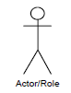
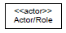
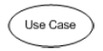
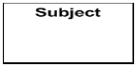
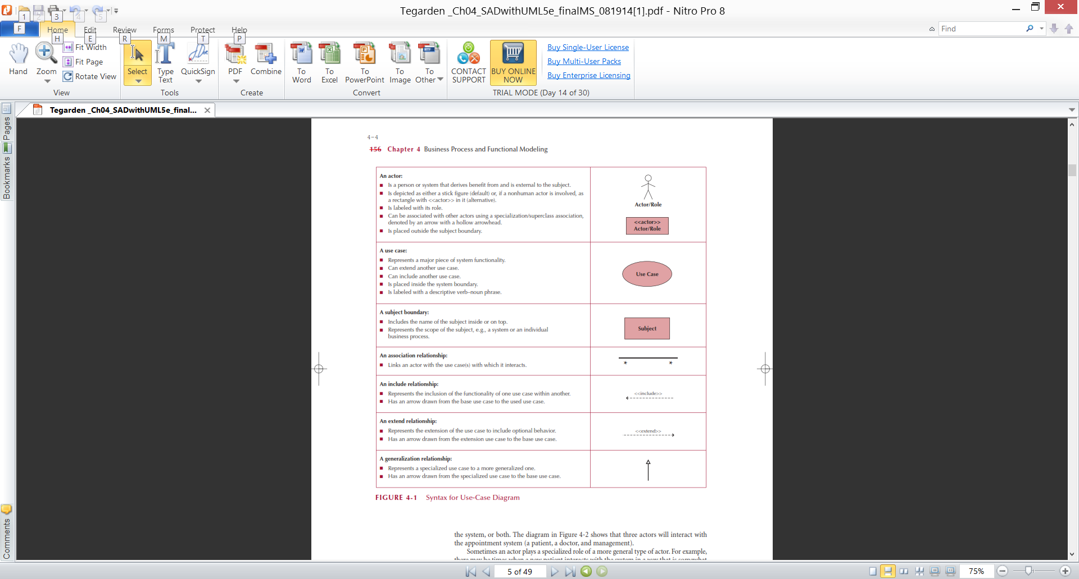
Business Process Identification With Use-Cases
Elements of Use-Case Diagrams 정리
Actors: users or other interacting systems
Associations: lines to connect actors and use-cases
Interactions, inclusions, extensions or generalizations
Use-case: a major process in the system that gives a benefit to the users
Subject boundary: a named box that depicts the scope of the system
An association relationship: links an actor with the use case(s) with which it interacts
Notes:
Use-case diagrams : very high level, simple, straightforward way of communication(시스템이 정확하게 무엇을 하면될까?)
시스템의 주요기능을 설명한다. 다른 사용자가 시스템의 주요 기능(high-level function)을 더하기하기에 좋다.
Actor : role, another system,

Slide 54
Business Process Identification With Use-Cases(Cont.)
Elements of Use-Case Diagrams
An include relationship: Represents the inclusion of the functionality of one use case within another
An extend relationship: Represents the extension of the use case to include optional behavior.
A generalization relationship: Represents a specialized use case to a more generalized one.
Notes:
정인상 보조 자료 활용

Slide 55
Use-Case Modeling Procedure
Step 1 : defining the system
Step 2 : finding actors
Step 3 : finding use cases
Step 4 : describing the use cases
Step 5 : defining the relationship between use cases
Step 6 : validating the model

Slide 56
Identifying Major Use-Cases
Review the requirements definition
Identify the subject’s boundaries
Identify the primary actors and their goals
Identify the business processes and major use-cases
Carefully review the current set of use-cases
Split or combine some to create the right size
Identify additional use-cases
Notes:
Use-case 의 주제 범위를 확실하게 정한다. – 나중에 변할 수 있다.
주요 액터 및 액터의 목적을 identif한다. – 관련자중의 하나다.
- 액터가 뭐하냐를밝힌다. – CRUDE(execute) any information, 시스템과 정보를 주고 받느냐?
Biz process 와 주요 use cases를 밝힌다.
유저케이스를 보면서 나눌지, 합칠지 --- 3-9개 정도의 주요 유저케이스를 찾는다.

Slide 57
Create a Use-Case Diagram
Place & draw the use-cases
Place & draw the actors
Draw the subject boundary
Add the associations
Notes:
쉽게, 겹치는 라인은 최소화, , factored out 하여 include, extend, generalization relation ships를 이용한다. (공통 use-case를 재활용하여 숫자를 줄인다.

Slide 58
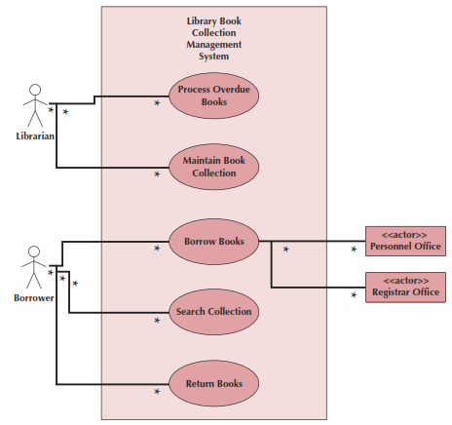
Example Use-Case
Library Book Collection
Management System
Use Case Diagram
Notes:
예제 교과서 128 페이지 참조

Slide 59
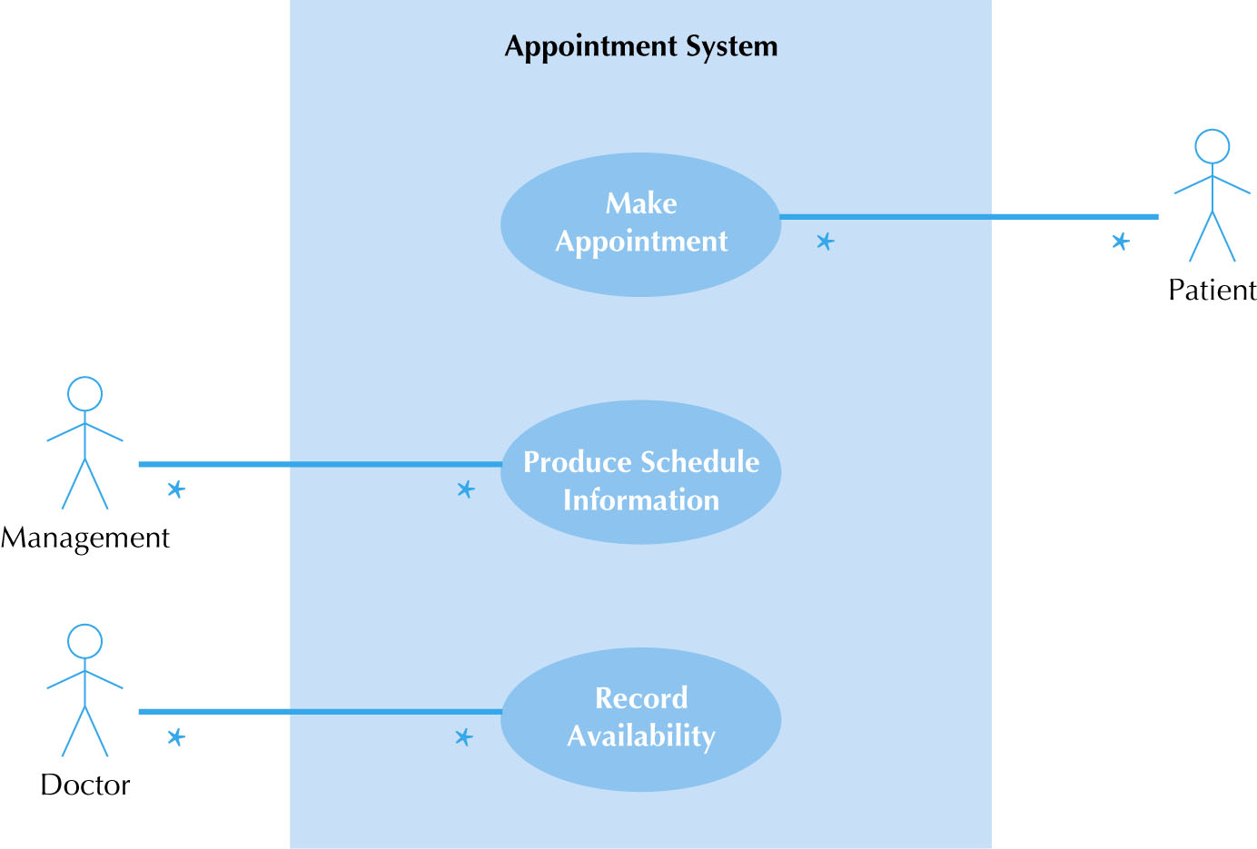
fig_05_08
Example Use-Case(1/3)
fig_05_08

Slide 60
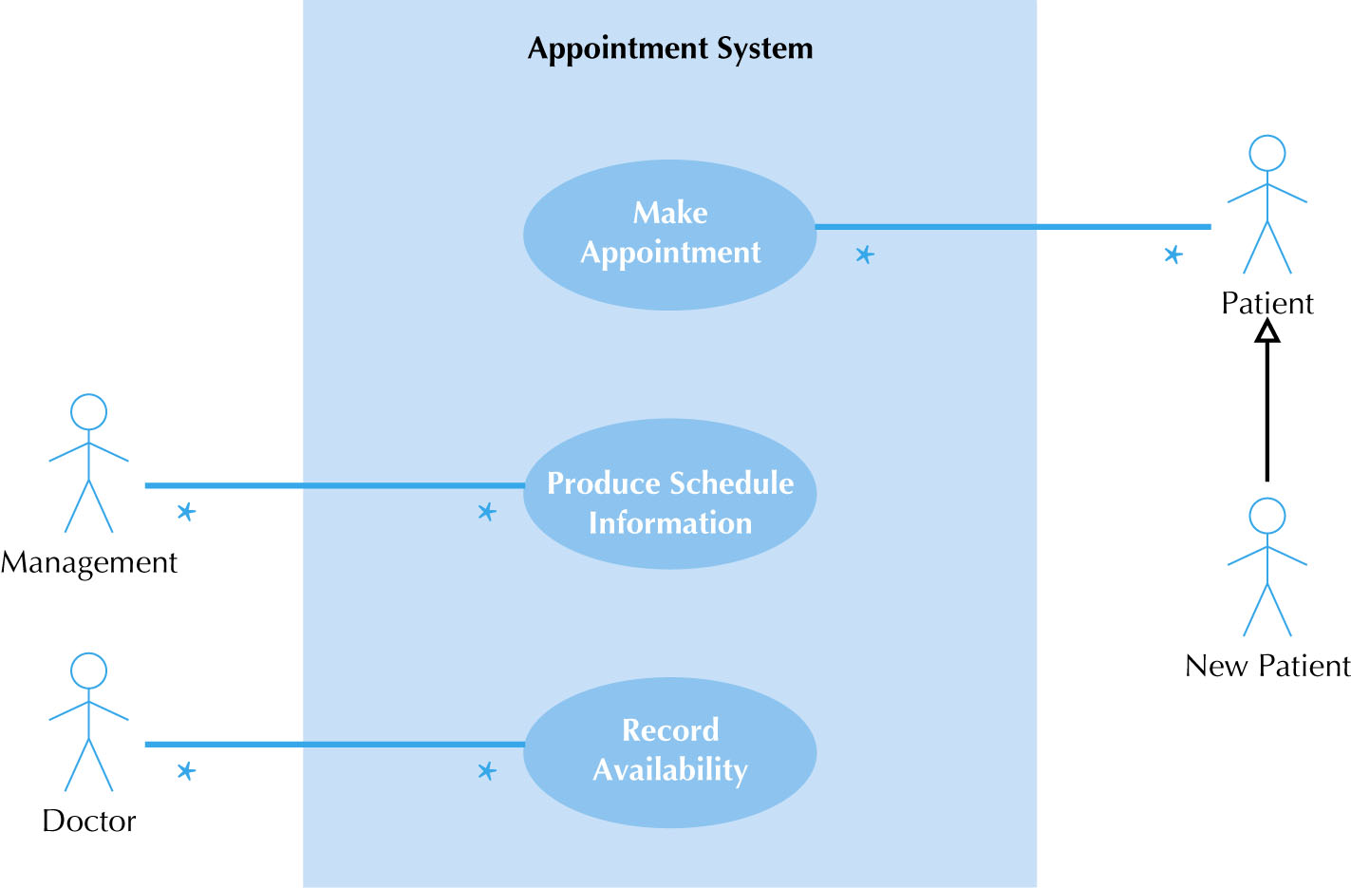
fig_05_09
Example Use-Case(2/3)
fig_05_09

Slide 61
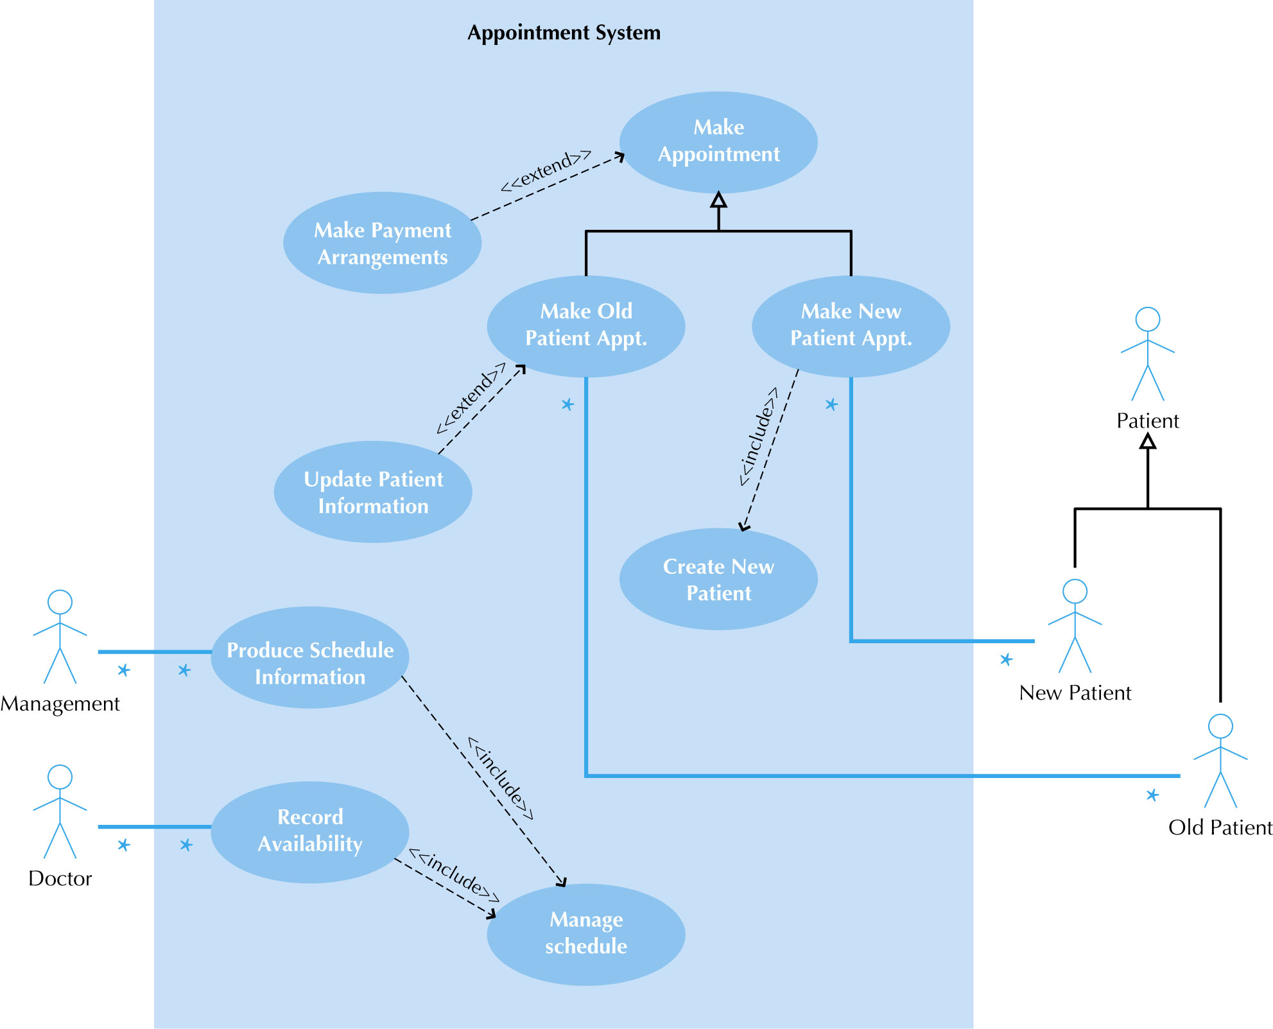
fig_05_10
Example Use-Case(3/3)
fig_05_10

Slide 62
Use Cases
The primary driver for all UML diagramming techniques
Depicts activities performed by the users
Describe basic functions of the system:
What the user can do
How the system responds
Use cases are building blocks for continued design activities
Each use-case describes 1 and only 1 function
* 예제 먼저보기

Slide 63
Types of Use Cases
Purpose | Amount of information
 |  | Overview | Detail
 | Essential | High-level overview of issues essential to understanding required functionality | Detailed description of issues essential to understanding required functionality
 | Real | High-level overview of a specific set of steps performed on the real system once implemented | Detailed description of a specific set of steps performed on the real system once implemented

Slide 64
Elements of a Use Case Description
Overview:
Name, ID Number, Type, Primary Actor, Brief Description, Importance Level, Stakeholder(s), Trigger(s)
Relationships:
Association: Communication between the use case and the actors
Extend: Extends the functionality of a use case
Include: Includes another use case
Generalization: Allows use cases to support inheritance
Flow of events
Normal flow: the usual set of activities
Sub-flows: decomposed normal flows to simplify the use-case
Alternate or exceptional flows: those not considered the norm
Optional characteristics (complexity, time, etc.)

Slide 65
Use Case Writing Guidelines
Write in the form of subject-verb-direct object
Make sure it is clear who the initiator of the step is
Write from independent observer’s perspective
Write at about the same level of abstraction
Ensure the use case has a sensible set of steps
Apply the KISS principle liberally.
Write repeating instructions after the set of steps to be repeated

Slide 68
Creating Use-Case Descriptions
Pick a high priority use-case and create an overview:
List the primary actor
Determine its type (overview or detail; essential or real)
List all stakeholders and their interests
Determine the level of importance of the use-case
Briefly describe the use-case
List what triggers the use-case
List its relationship to other use-cases
Fill in the steps of the normal flow of events required to complete the use-case

Slide 69
Creating Use-Case Descriptions (cont.)
Ensure that the steps listed are not too complicated or long and are consistent in size with other steps
Identify and write the alternate or exceptional flows
Carefully review the use-case description and confirm that it is correct
Iterate over the entire set of steps again

Slide 70
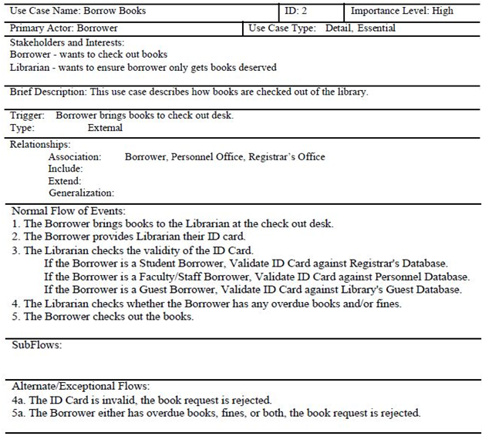
Example Use-Case Description

Slide 71
Verifying & Validating a Use-Case
Use-cases must be verified and validated before beginning structural and behavioral modeling
Utilize a walkthrough:
Perform a review of the models and diagrams created so far
Performed by individuals from the development team and the client (very interactive)
Facilitator: schedule and set up the meeting
Presenter: the one who is responsible for the specific representation being reviewed
Recorder (scribe) to take notes and especially to document errors

Slide 72
예제 프로그램
장난감 쇼핑몰
인터넷에서 회원제로 어린이 장난감을 파는 쇼핑몰을 구축하려고 한다. 이 쇼핑몰에서 물건을 사기 위해서는 우선 회원으로 등록하여야 한다. 물건을 살 때는 은행 또는 카드 회사와 연계하여 구매금액을 결제할 수 있어야 한다. 그리고 우수 회원에게는 할인 혜택을 제공한다. 쇼핑몰 관리자는 주기적으로 쇼핑몰의 물건 리스트와 수량을 관리할 수 있어야 한다.

Slide 73
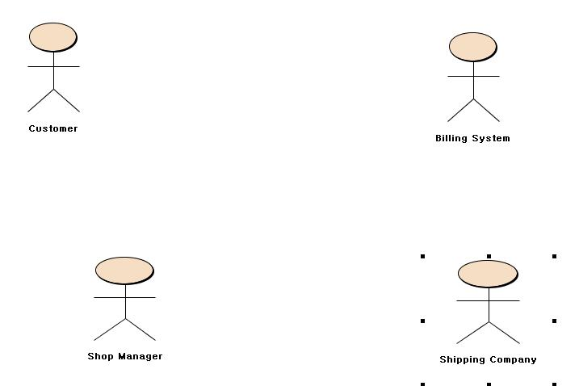
단계 1, 2 : System 정의 및 Actor 추출

Slide 74
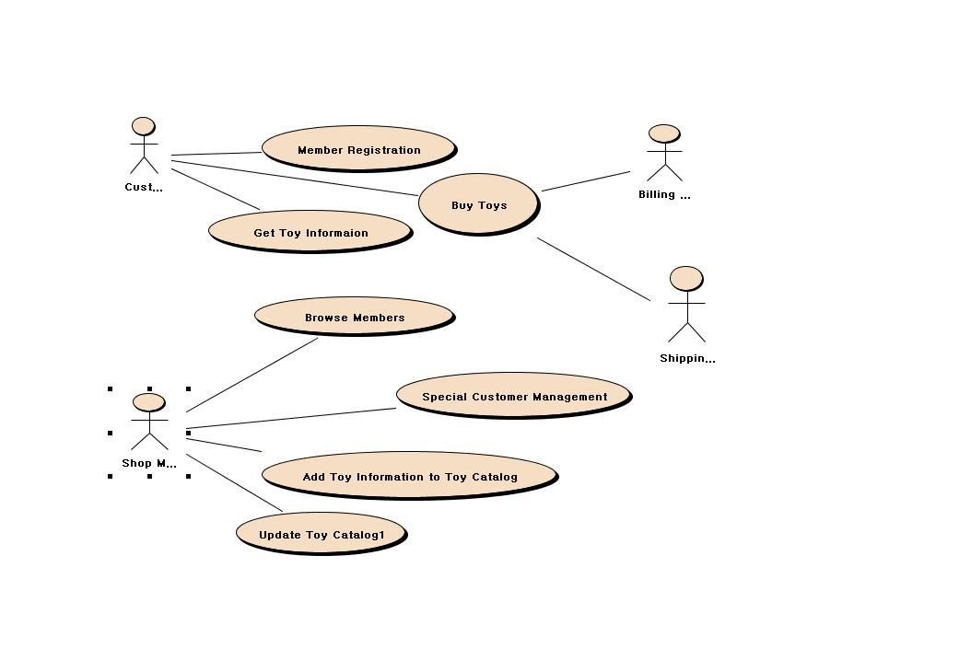
단계 3 : Use Case 추출

Slide 75
단계 4 : Use Case Description
UC : Member Registration
선행조건: 없음
기본 흐름
1. 고객의 이름, 주소, 주민등록번호, 전화번호, 성별 및 직업 등을 입력한다
2. 고객은 자신이 사용할 id와 패스워드를 입력한다.
3. 시스템은 고객정보를 저장한다.
예외 흐름
1. 만약 고객의 id가 다른 멤버와 중복되면 이 사실을 고객에게 알리고 다른 id를 사용할 것을 요구한다.

Slide 76
Elements of a Use-Case Description
Use Case Name: ID: Importance Level:
Primary Actor: Use Case Type:
Stakeholders and Interests:
Brief Description:
Trigger:
Relationships: (Association, Include, Extend, Generalization)
Normal Flow of Events:
Subflows:
Alternate/Exceptional Flows:

Slide 77
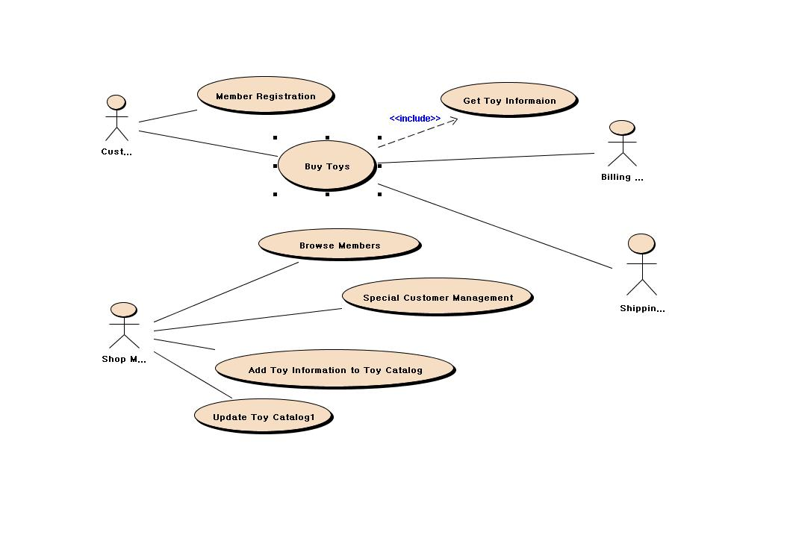
단계 5 : Use Case 간의 관계 설정 (1)

Slide 78
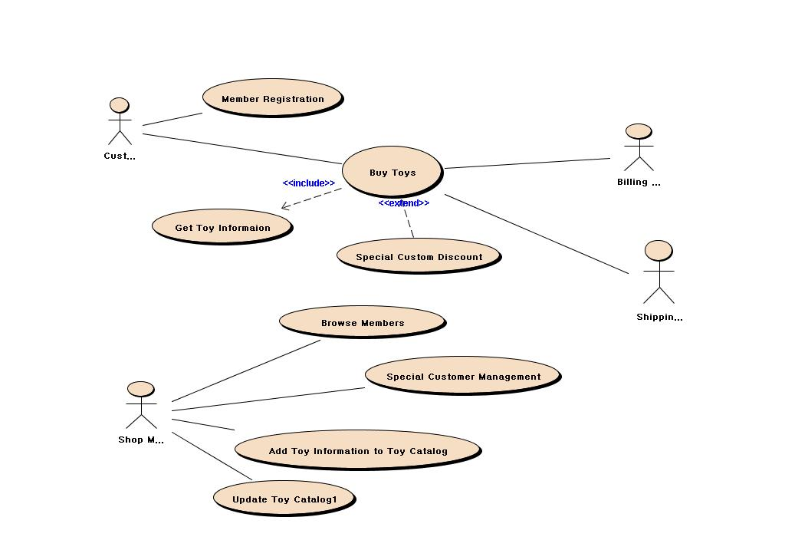
단계 5 : Use Case 간의 관계 설정 (2)

Slide 79
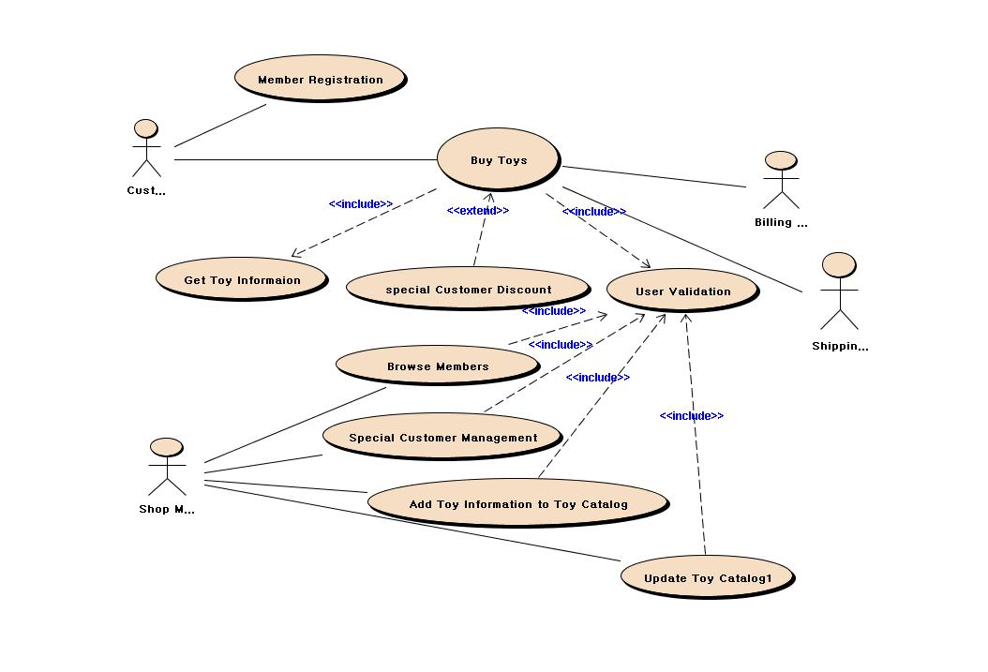
단계 5 : Use Case 간의 관계 설정 (3)

Slide 80
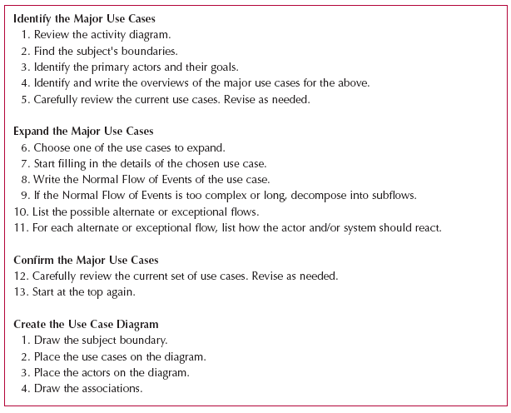
Writing Effective Use-Case Descriptions

Slide 82
Rules for Verification & Validation
Ensure one recorded event in the flows of the use-case description for each action/activity on the activity diagram
All objects in an activity diagram must be mentioned in an event of the use-case description
The sequence of the use-case description should match the sequence in the activity diagram
One and only one description for each use-case
All actors listed in a use-case description must be shown on the use-case diagram
Stakeholders listed in the use-case description may be shown on the use-case diagram (check local policy)
All relationships in the use-case description must be depicted on the use-case diagram
All diagram-specific rules must be enforced
Notes:
Activity diagram 과 use-case 기술 사이의 체크
Action -> event
Activity diagram에 나타나는 activity 의 시퀏스와 use-case 기술에 나타나는 시퀀스 가 매치되는가
Use-case diagram 과 use-case description 사이의 일관성 체크

Slide 83
Use Case Modeling Pitfalls

Slide 84
Use Case Diagram Pitfall 1
Data Representation
Processing order
<<include>> meaning ?
Login
Order
<<include>>
<<include>>
Manage
Bill
Manager
Customer
Menu
Table

Slide 85
Use Case Diagram Pitfall 2
Abstraction Level
System Scope
Login
Order
<<include>>
Manage
Customer
Bill
Manager
<<include>>
<<include>>
add
del
Card Company

Slide 86
Use Case Diagram Pitfall 3
Member Registration
Estimate Cost of Order
Visitor
Or
Buyer
Get Company Info
Exclude
CEO
Order electronics
<Include>
<Include>
Get Company History
<Include>
Get Catalog
<Include>
User Validation
Members
Management
<Include>
Update Catalog
<Include>
manufactory
Manager
Homepage
Manager
Update Homepage

Slide 87
Use Case Modeling 예제

Slide 88
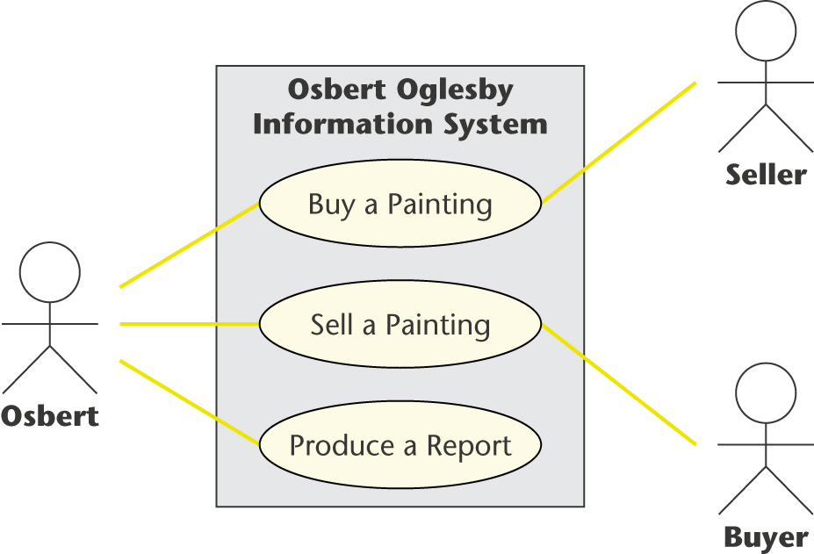
Use case diagram 실습 I

Slide 89
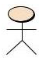
Use case diagram 실습 II
쇼핑(둘러보기)
<<include>>
Login
Buyer
구매
<<include>>
물품배송정보확인
Transporter
<<include>>
물품 list 관리
Seller
Manager

Slide 90
Use case diagram 실습 III
화상채팅
시스템
관리
<<extend>>
채팅
회원
관리
<<include>>
파일전송
로그인
관리자
유저
쪽지
보내기
친구
관리
공지하기

Slide 91
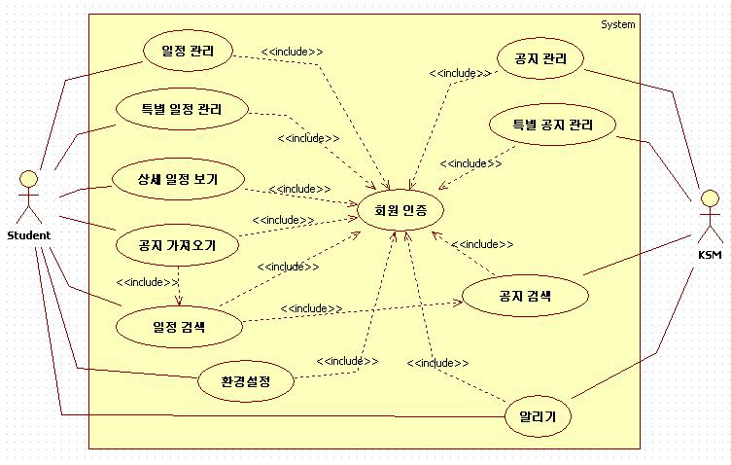
Use Case Diagram 실습 IV

Slide 92
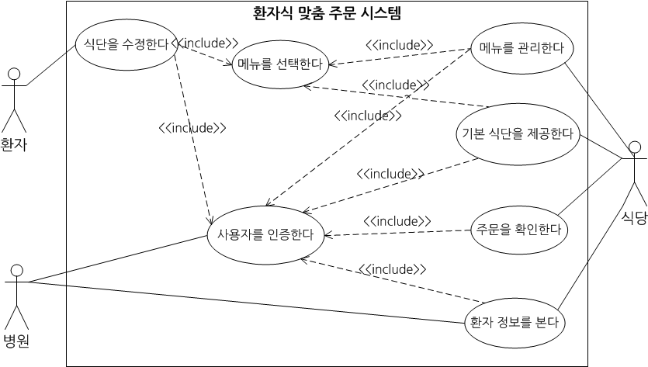
Use Case Diagram 실습 V

Slide 93
Summary
Presented in this chapter:
The identification of business processes using use-case diagrams and descriptions
Modeling business processes with activity diagrams
How to create the documentation of use-cases and use-case descriptions
How to verify and validate the business processes and functional models

